Slide 1
Introducing the terminology
Enterprise software is computer software used to satisfy the needs of an organization.
Martin Fowler: "Enterprise applications are about the display, manipulation, and storage of large amounts of often complex data and the support or automation of business processes with that data."
https://en.wikipedia.org/wiki/Enterprise_software

Slide 2
Example
Right automatization
By Max Dorofeev
https://youtu.be/XDF02KmgJFE?t=1h6m26s

Slide 3
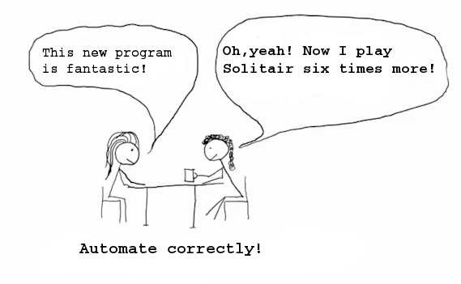

Slide 4
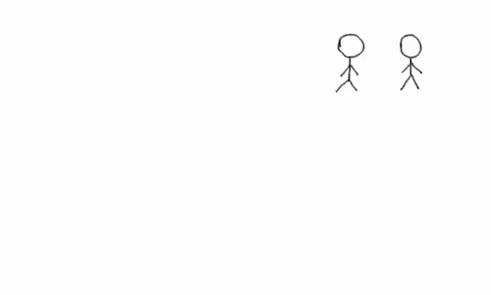

Slide 5
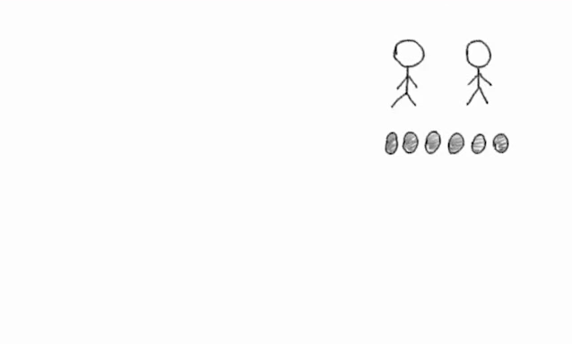

Slide 6
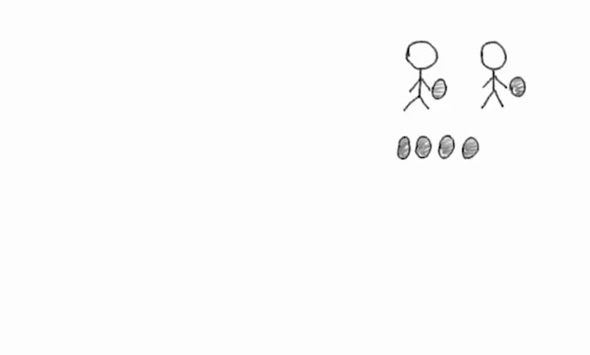

Slide 7
It is necessary to pass report!

Slide 8
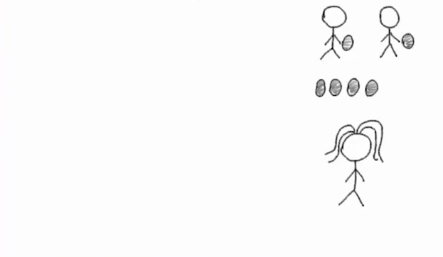
It is necessary to pass report!

Slide 9
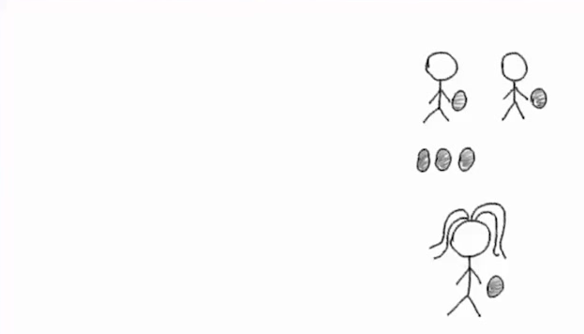
It is necessary to pass report!

Slide 10
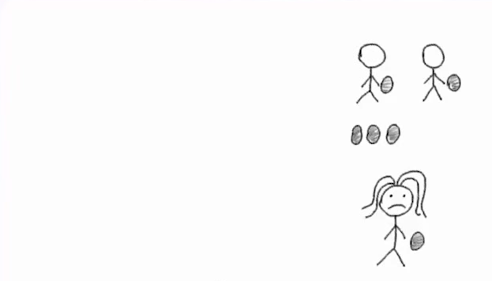
It is necessary to pass report!

Slide 11
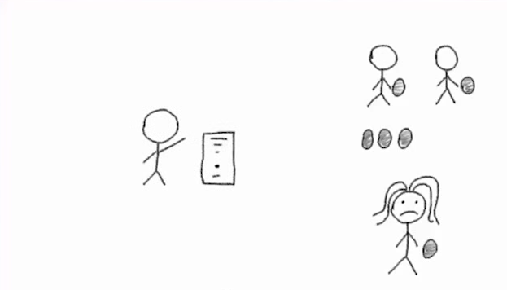
It is necessary to pass report!

Slide 12
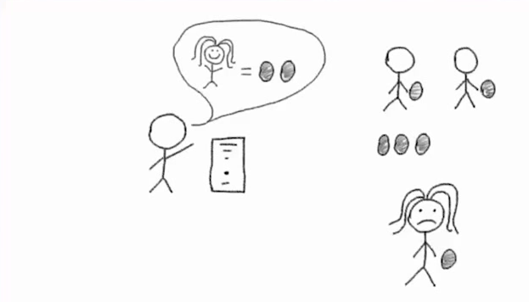
It is necessary to pass report!

Slide 13
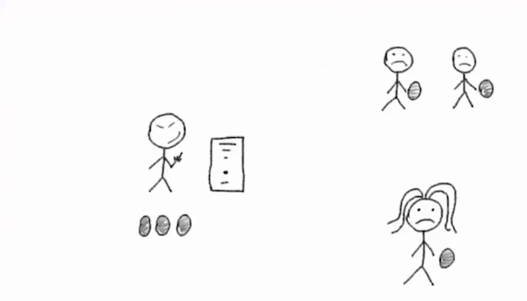
It is necessary to pass report!

Slide 14
Every 4th fails!!!
(* CHAOS report)
It is necessary to pass report!
* https://www.projectsmart.co.uk/white-papers/chaos-report.pdf

Slide 15
Every 4th fails!!!
(* CHAOS report)
It is necessary to pass report!
* https://www.projectsmart.co.uk/white-papers/chaos-report.pdf

Slide 16
It is necessary to pass report!

Slide 17
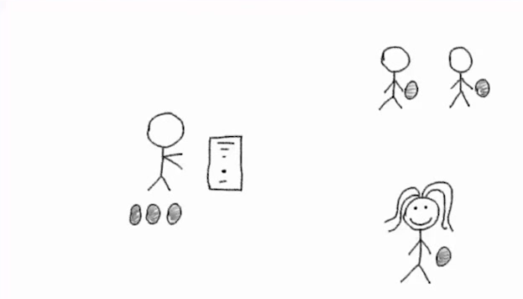
It is necessary to pass report!

Slide 18
It is necessary to pass report!

Slide 19
It is necessary to pass report!

Slide 20
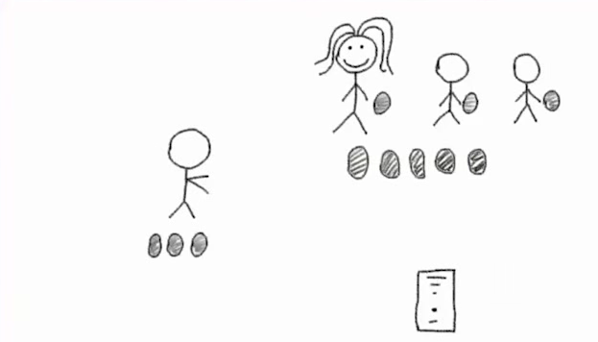
It is necessary to pass report!

Slide 21
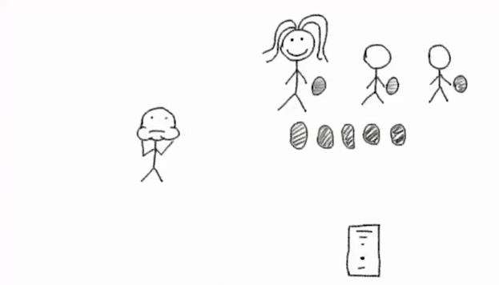
It is necessary to pass report!

Slide 22
It is necessary to pass report!
Benefit!

Slide 23
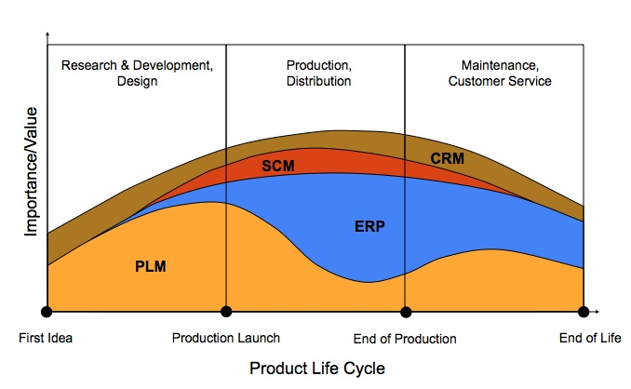

Slide 24
CRM - Customer relationship Management - is an approach to manage a company's interaction with current and potential customers. It uses data analysis about customers' history with a company to improve business relationships with customers, specifically focusing on customer retention and ultimately driving sales growth.
SCM - Supply Chain Management - the management of the flow of goods and services, involves the movement and storage of raw materials, of work-in-process inventory, and of finished goods from point of origin to point of consumption.
ERP - Enterprise Resource Planning - track business resources—cash, raw materials, production capacity—and the status of business commitments: orders, purchase orders, and payroll.
PLM - Product Lifecycle Management - is the process of managing the entire lifecycle of a product from inception, through engineering design and manufacture, to service and disposal of manufactured products. PLM integrates people, data, processes and business systems and provides a product information backbone for companies and their extended enterprise.

Slide 25

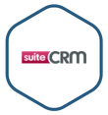


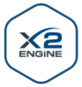


CRM vendors and software, examples
ERPNext
Opensource
https://en.wikipedia.org/wiki/Comparison_of_CRM_systems, https://bitnami.com/stacks/crm

Slide 26




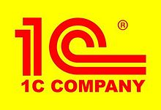
ERP vendors and software, examples
ERPNext
Opensource
https://en.wikipedia.org/wiki/List_of_ERP_software_packages

Slide 27


ECM (enterprise content management)vendors and software, examples
Opensource

Slide 28




PLM vendors and software, examples

Slide 29
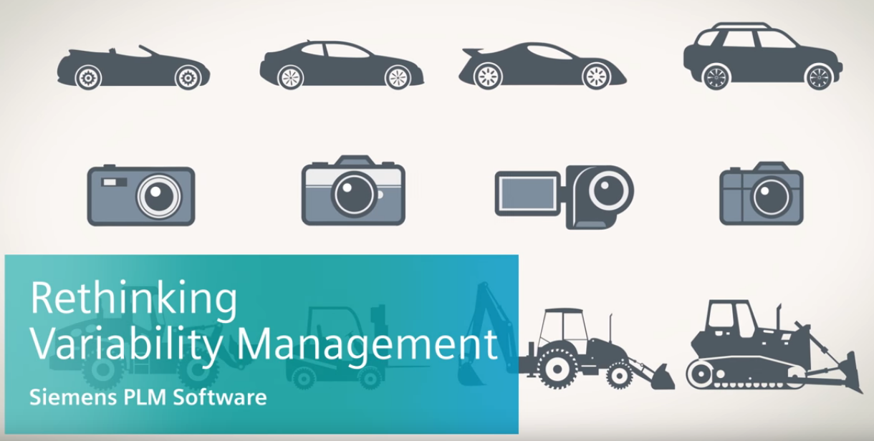
Product configurator Software in PLM

Slide 30
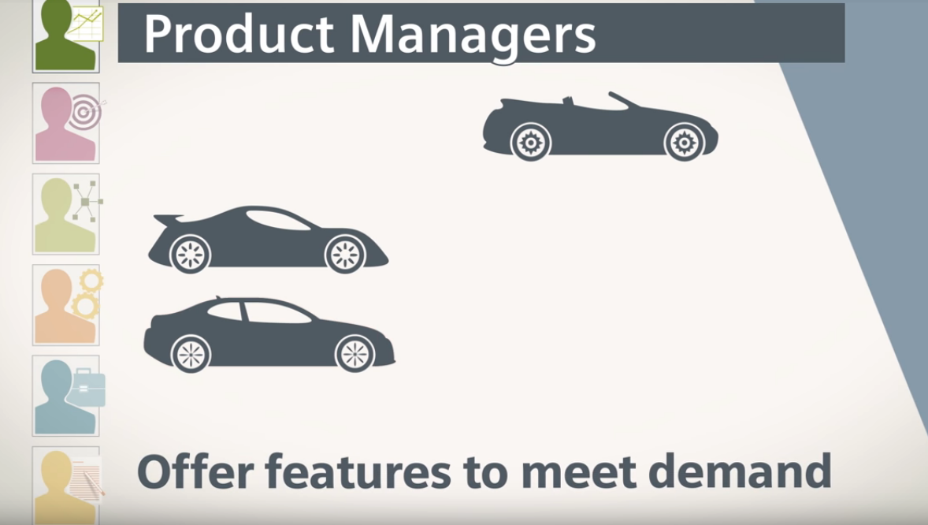

Slide 31
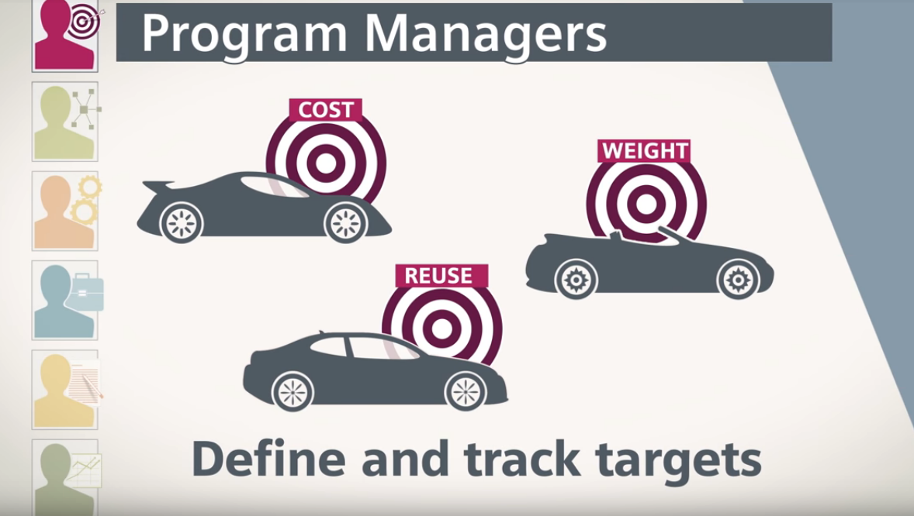

Slide 32
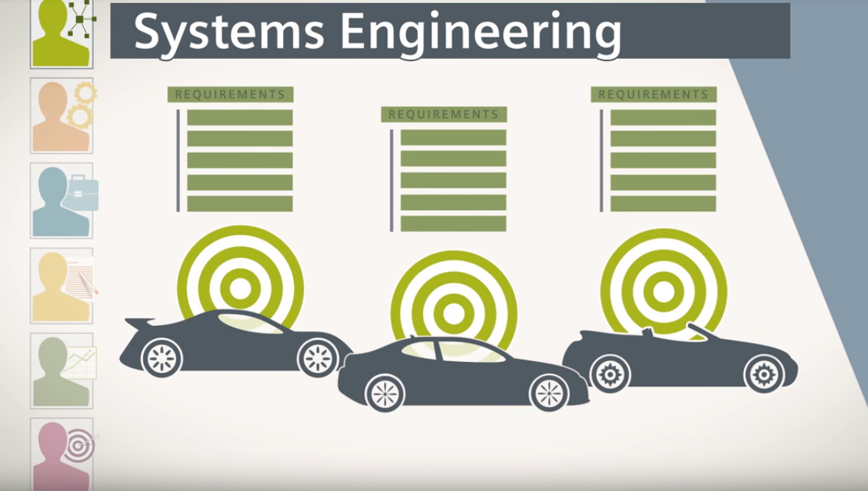

Slide 33
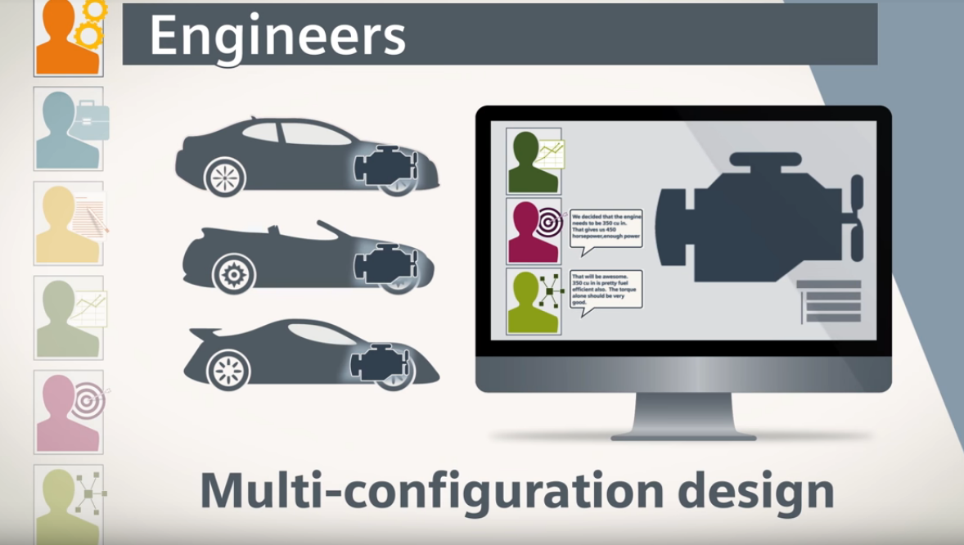

Slide 34
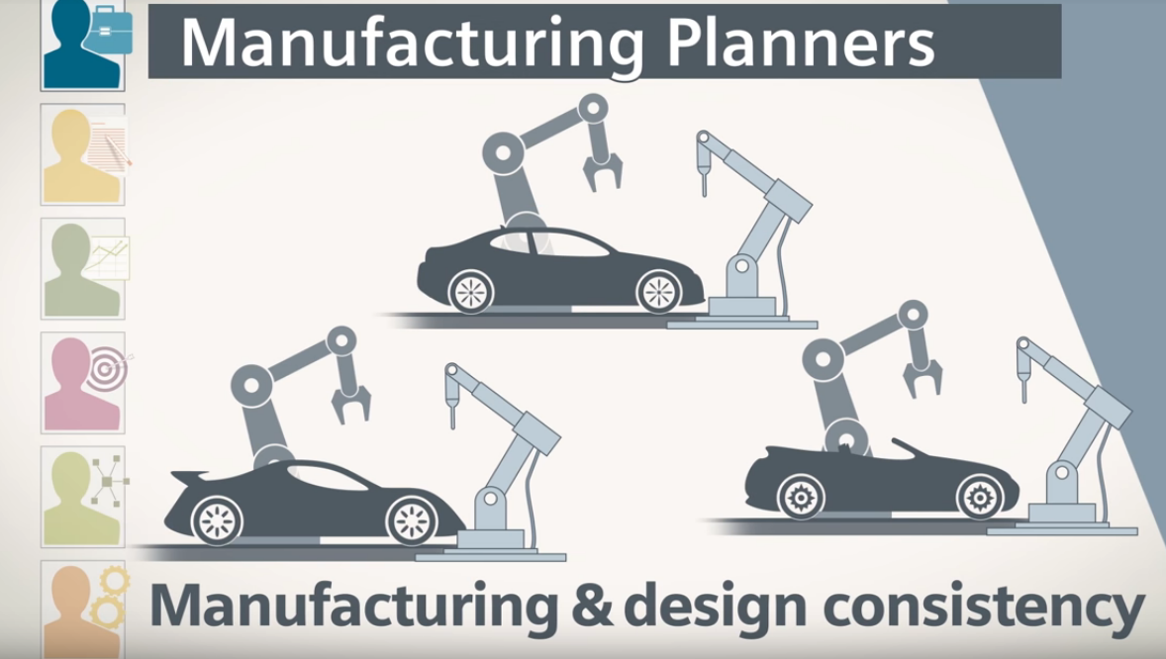

Slide 35
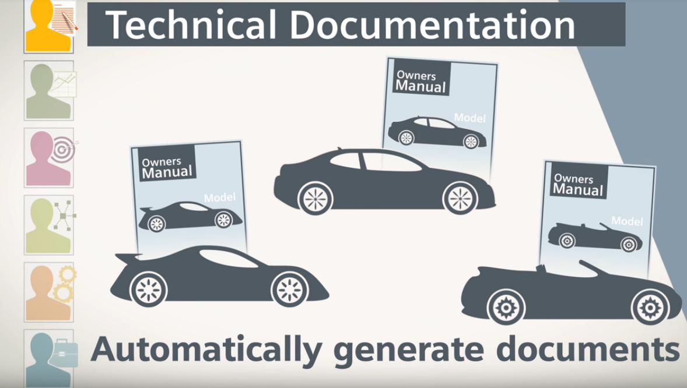

Slide 36
